Slide 1
As the Church is an important part of school life, the children have put forward their views on the role of the Vicar in our School and Community.
Here are their thoughts …
"...life in all its fullness" John 10.10

Slide 2
Comments from Year 6
“A ‘gentle’ man or woman.”
“We would love the Vicar to visit St. John’s Primary Academy, for a little bit each week.”
“We think our Vicar should be smart, respectful, kind and caring.”
“We would like the Vicar to be themselves.”

Slide 3
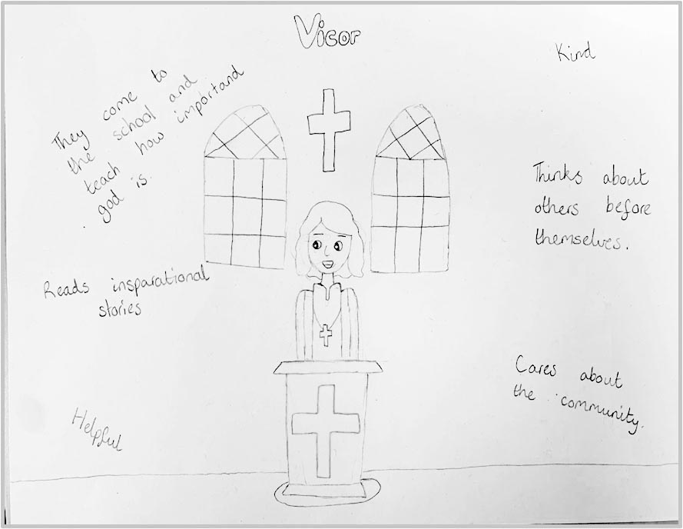
Key Stage 2
“Read inspirational stories”
“Come to school to teach the importance of God.”

Slide 4
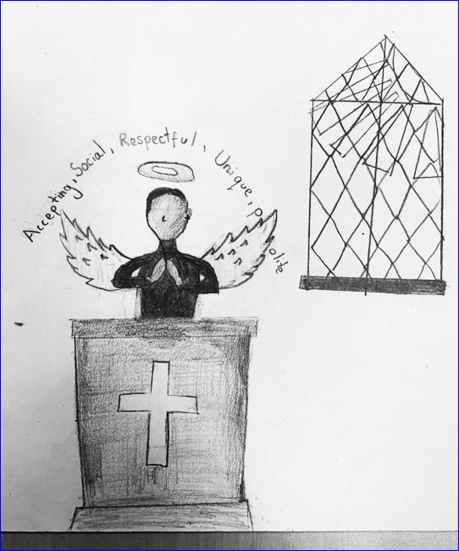
Year 6
“Accepting,
Social,
Respectful,
Unique,
Polite”

Slide 5
Year 6
“Caring towards our Community”

Slide 6
Year 6
“Caring,
Respectful, Kind”

Slide 7
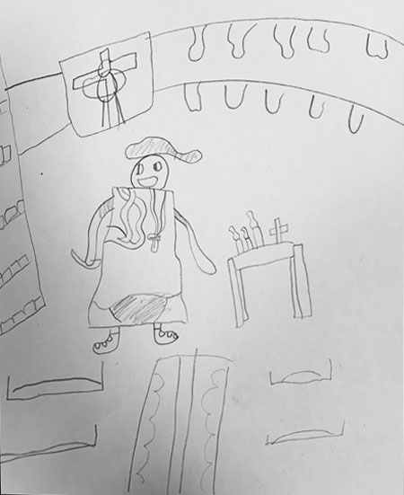
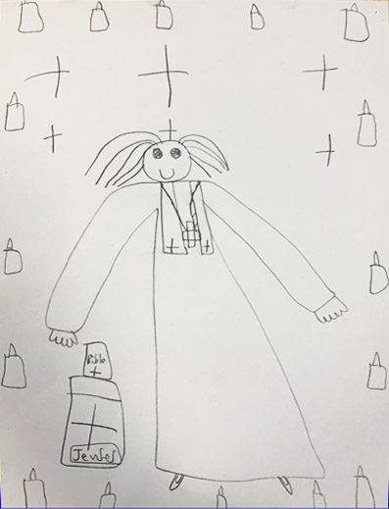
Year 3
Year 3 had a consistent message that they would like to convey through their drawings…
It doesn’t matter what our new Vicar looks like, in any way, Man or Woman. What is inside is more important.”

Slide 8
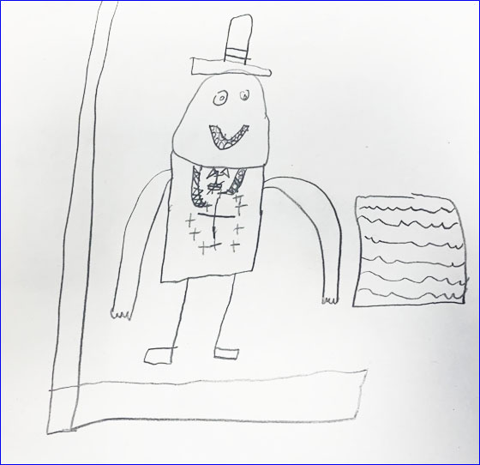
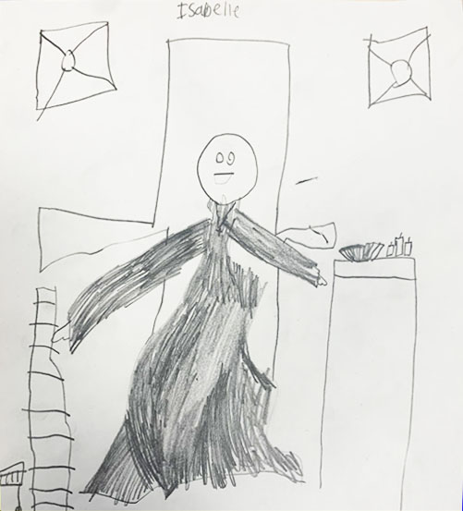
Year 3’s Drawings

Slide 9
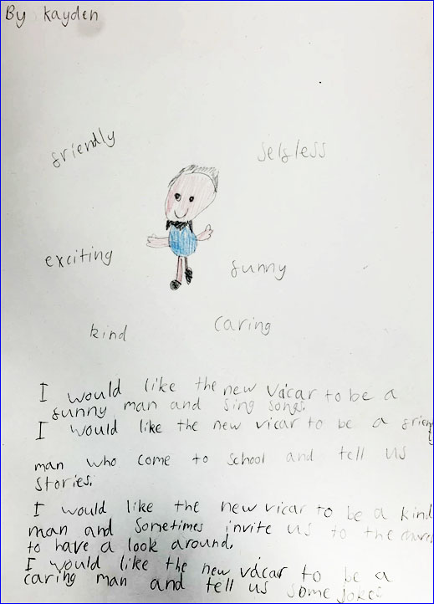
Key Stage 1
Year 2 children felt that it was important that the Vicar shares stories form the Bible and talks to the children when they visit school.

Slide 10
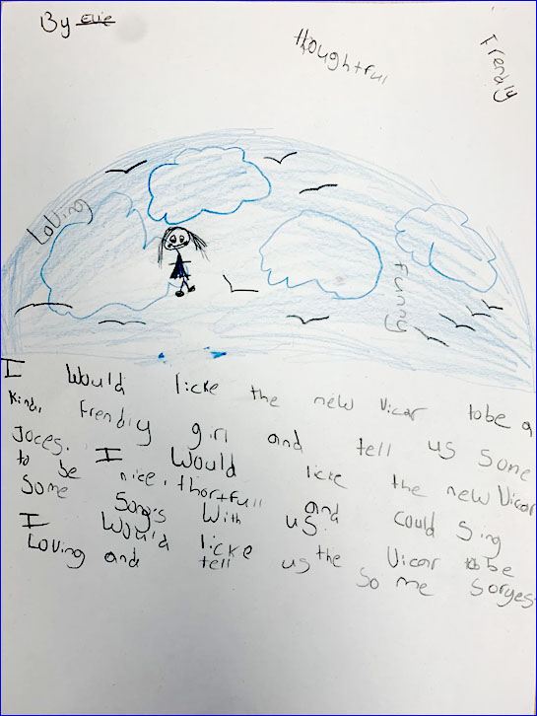
Year 2 were excited to sing songs with the new Vicar!

Slide 11
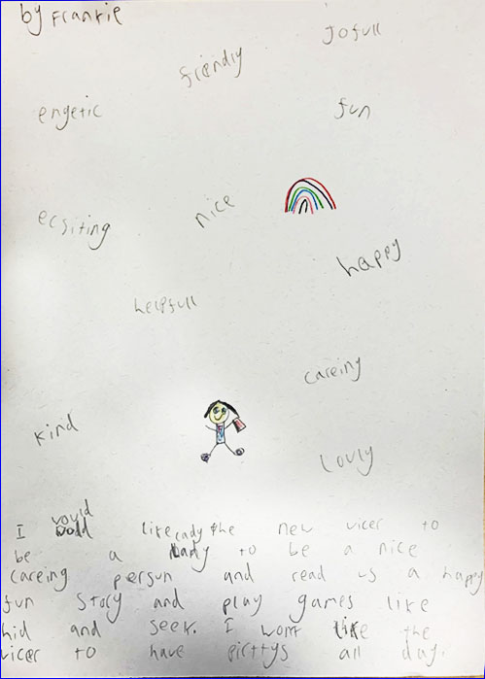
Year 2 were excited to spend time with the new Vicar and hoped that they would be friendly and fun!

Slide 12
Reverence ∙ Endurance ∙ Friendship ∙ Koinonia

